Slide 1
Linear Regression - e-commerce

Slide 2
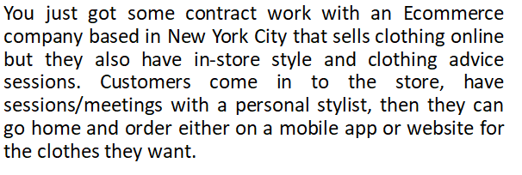
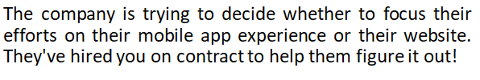
Problem Statement

Slide 3
Pre-processing
The dataset contains the 8 columns and 500 rows.
The several columns are not important for the prediction so they are removed.

Slide 4
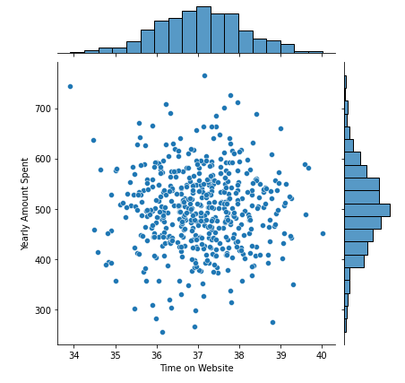
Pre-processing
It shows the relationship between the Time on website and Yearly Amount Spent

Slide 5
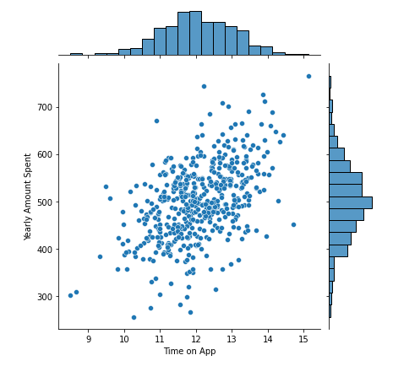
Pre-processing
The relationship between the Yearly Amount Spent and Time on App

Slide 6
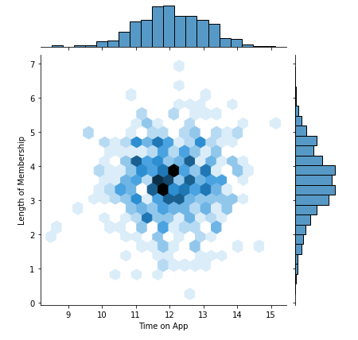
Pre-processing
The relationship between Length of Membership and Time on App

Slide 7
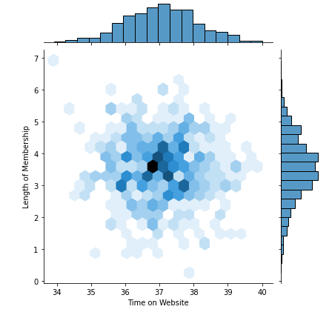
Pre-processing
The relationship between the Time on website and Length of Membership

Slide 8
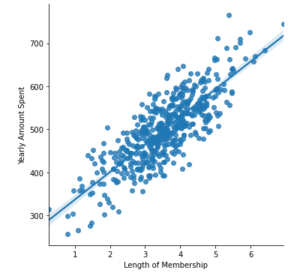
Pre-processing
The relationship between Length of Membership and Yearly Amount spent

Slide 9
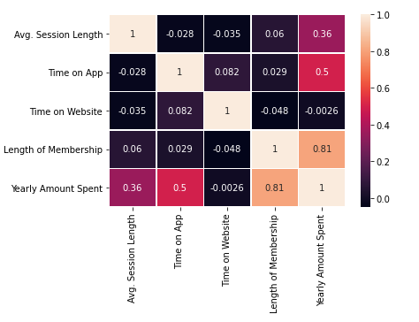
Pre-processing
It’s the cor-relationship between all the features.

Slide 10
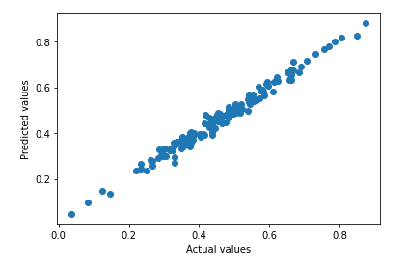
Result
The resultant graph of Predicted values and Actual values and accuracy of 98.12

